Slide 1
Cross Cutting Concepts
Science

Slide 2
What are Cross Cutting Concepts (CCC’s)?
They are the big ideas that connect the sciences and help us understand nature and how science and engineering work.

Slide 3
There are 7 CCC’s
Patterns
Cause and Effect
Scale, Proportion, and Quantity
Systems and System Models
Energy and Matter
Structure and Function
Stability and Change

Slide 4
For your Notes:
Front:
Cross Cutting Concepts
Inside Left Flap:
7 CCC’s
Inside :
Big Ideas that
Connect the Sciences
Help us understand nature, science and engineering

Slide 5
Patterns

Slide 6
Patterns
Patterns can be observed, used to describe events, and used as evidence.
Similarities and differences in patterns can be used to sort, classify, communicate and analyze.
Graphs, charts and images can be used to identify patterns in data.

Slide 7
Examples of Patterns

Slide 8
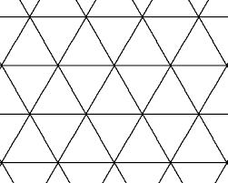
For your Notes
Front:
Patterns
Inside on Flap:
Inside :
Sort and analyze
Evidence
Graphs, charts, images

Slide 9
Cause and Effect

Slide 10
Cause and Effect
Events have causes that generate observable patterns.
Cause and effect relationships can be used to explain change.
Cause and effect relationships can be use to predict events in systems.

Slide 11
Examples of Cause and Effect

Slide 12
For your Notes
Front:
Cause and Effect
Inside on Flap:
Inside :
Observable patterns
Explains change
Used for predictions

Slide 13
Scale, Proportion and Quantity

Slide 14
Scale, Proportion & Quantity
Relative scales allow for comparisons.(bigger & smaller, hotter & colder, faster & slower, etc.).
Standard units used to measure and describe physical quantities (weight, time, temp, volume).
Some systems can only be studied indirectly because they are too small, large, fast or slow to observe directly.

Slide 15
Examples of Scale and Proportion

Slide 16
For your Notes
Front:
Scale, Proportion and Quantity
Inside on Flap:
Inside :
Comparisons
Units for measurement
Allows for indirect study

Slide 17
Systems and System Models

Slide 18
Systems and System Models
Objects and organisms can be described in terms of their parts.
A system is a group of related parts that make up a whole and can carry out functions its individual parts cannot.
Models can be used to represent systems and their interactions such as:
Inputs, processes and outputs
Energy, matter and flows within systems

Slide 19
Examples of Systems and System Models

Slide 20
For your Notes
Front:
Systems and System Models
Inside on Flap:
Inside :
Objects are described by their parts.
The parts work together as a whole.

Slide 21
Energy and Matter

Slide 22
Energy and Matter
Objects may break into smaller pieces, be put together into larger pieces, or change shapes,
Matter is made of particles.
Matter cannot be created or destroyed, only transferred in various ways between objects.
Matter is conserved because atoms are conserved in physical and chemical processes.

Slide 23
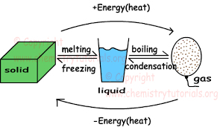
Examples of Energy and Matter

Slide 24
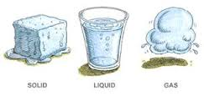
For your Notes
Front:
Energy and Matter
Inside on Flap:
Inside :
Objects can change shape or size.
Matter cannot be created or destroyed.
Matter is transferred in lots of ways.

Slide 25
Structure and Function

Slide 26
Structure and Function
The shape and stability of structures are related to their functions.
Structures can be modeled and used to describe how their function depends on the relationships among its parts.
Structures can be designed to serve particular functions taking into account properties of different materials.

Slide 27
Examples of Structure and Function

Slide 28
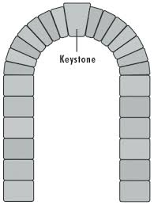
For your Notes
Front:
Structure and Function
Inside on Flap:
Inside :
Stability of structure related to function.
Function depends on relationship of parts.
Structures are designed for particular functions.

Slide 29
Stability and Change

Slide 30
Stability and Change
Some things stay the same while some things change.
Things may change slowly or rapidly.
Change is measured in terms of difference over time and may occur at different rates.
Small changes in one part of a system might cause large changes in another part.
Stability might be disturbed either by sudden events or gradual changes that accumulate over time.
Some system changes are irreversible.

Slide 31
Examples of Stability and Change

Slide 32
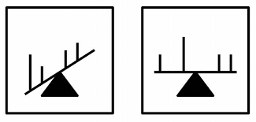
For your Notes
Front:
Stability and Change
Inside on Flap:
Inside :
Change can occur slowly or rapidly
Measured in differences over time.
Small changes can cause large changes somewhere else.
Some changes are irreversible.

Slide 33
Cross Cutting Concepts
We will be integrating each of these Cross Cutting Concepts into everything we learn throughout the year.

