Slide 1
Mystery Boxes

Slide 2
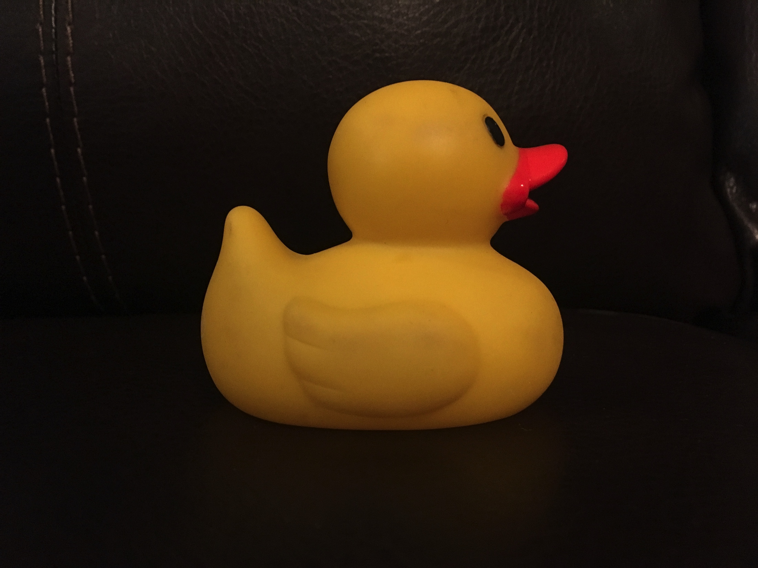
Box #1
Rubber Duck

Slide 3
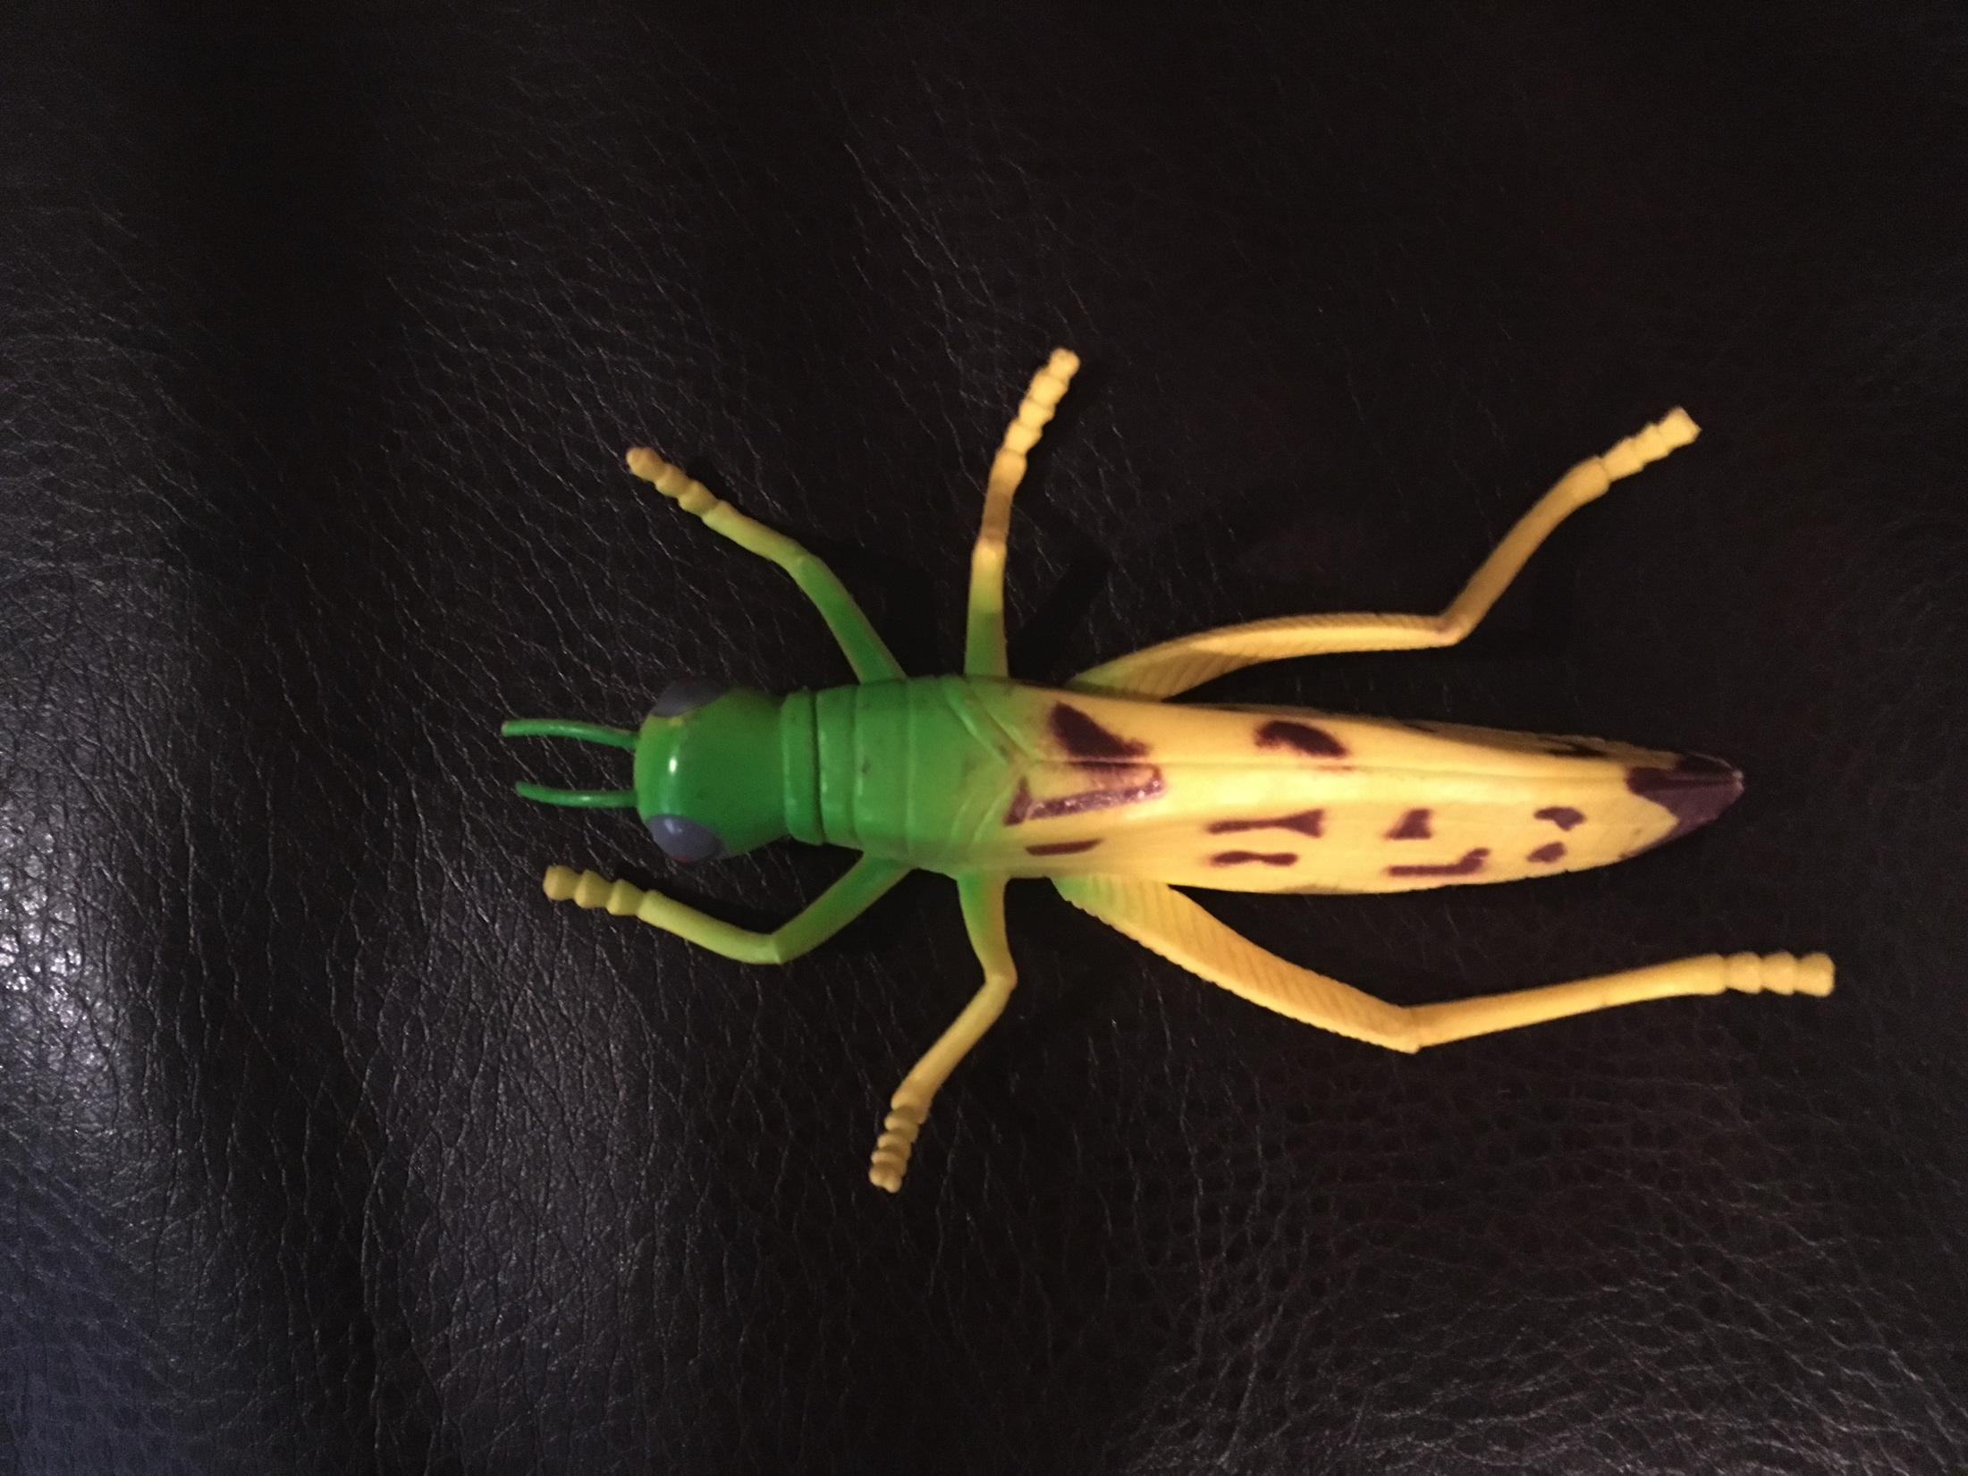
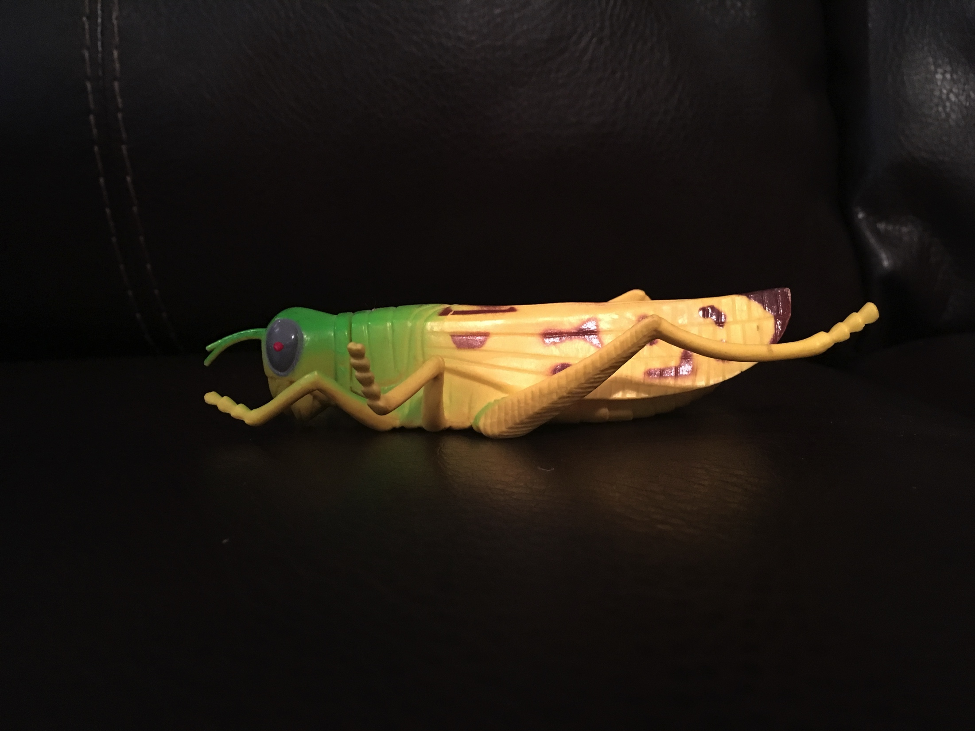
Box #2 Grasshopper

Slide 4
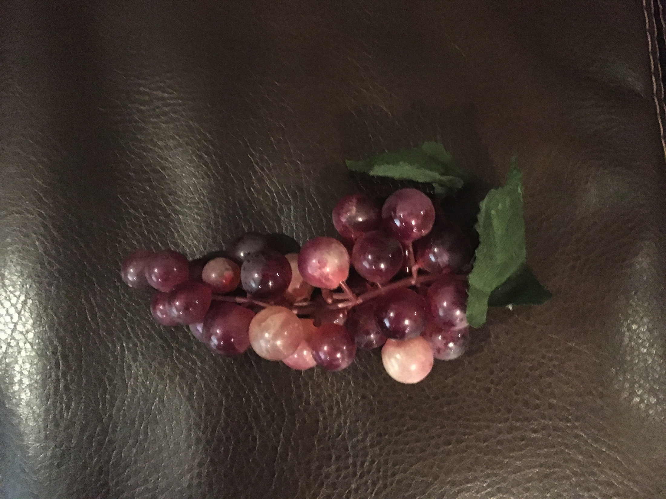
Box #3
Plastic Grapes

Slide 5
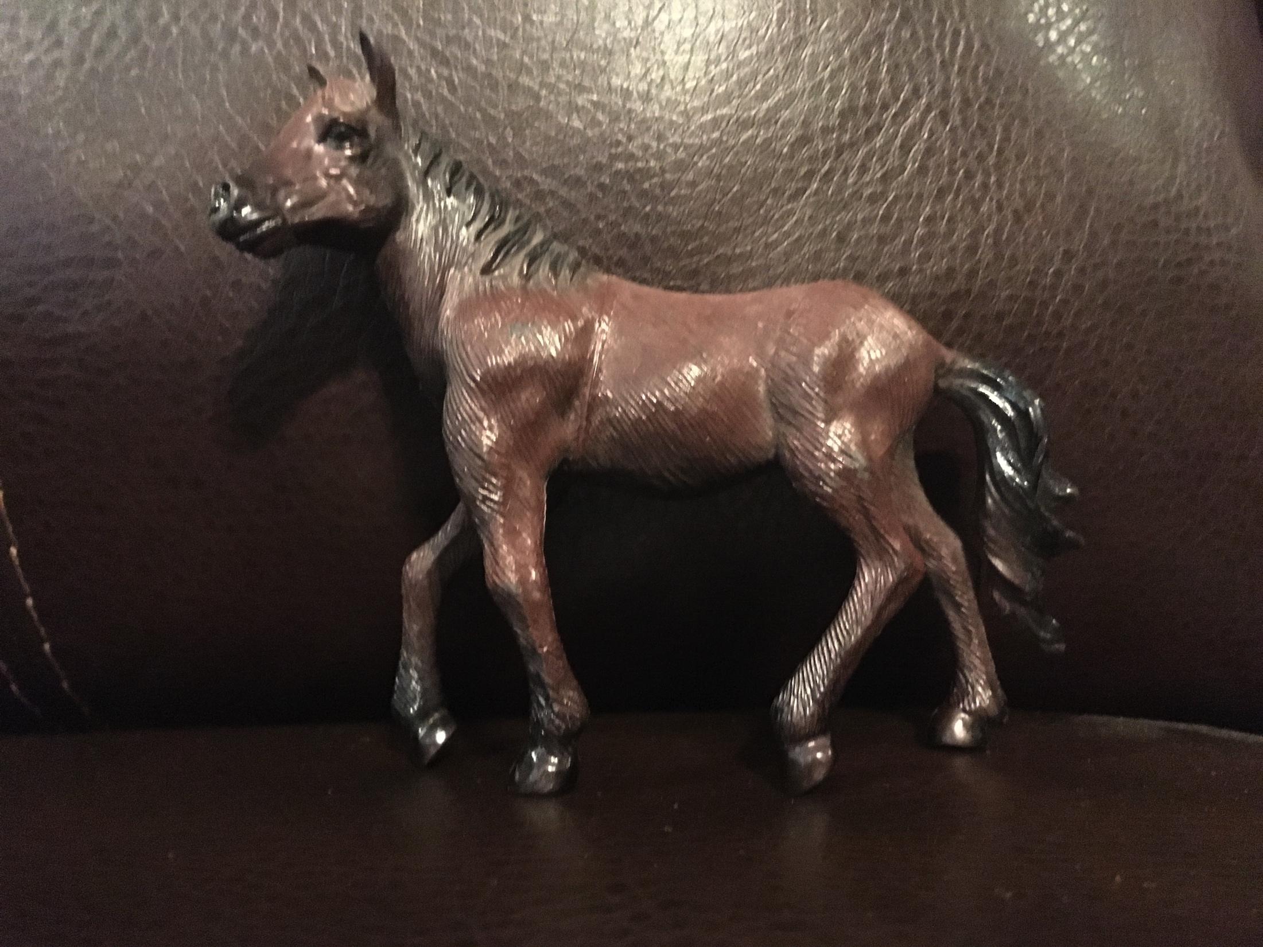
Box #4 Toy Horse

Slide 6
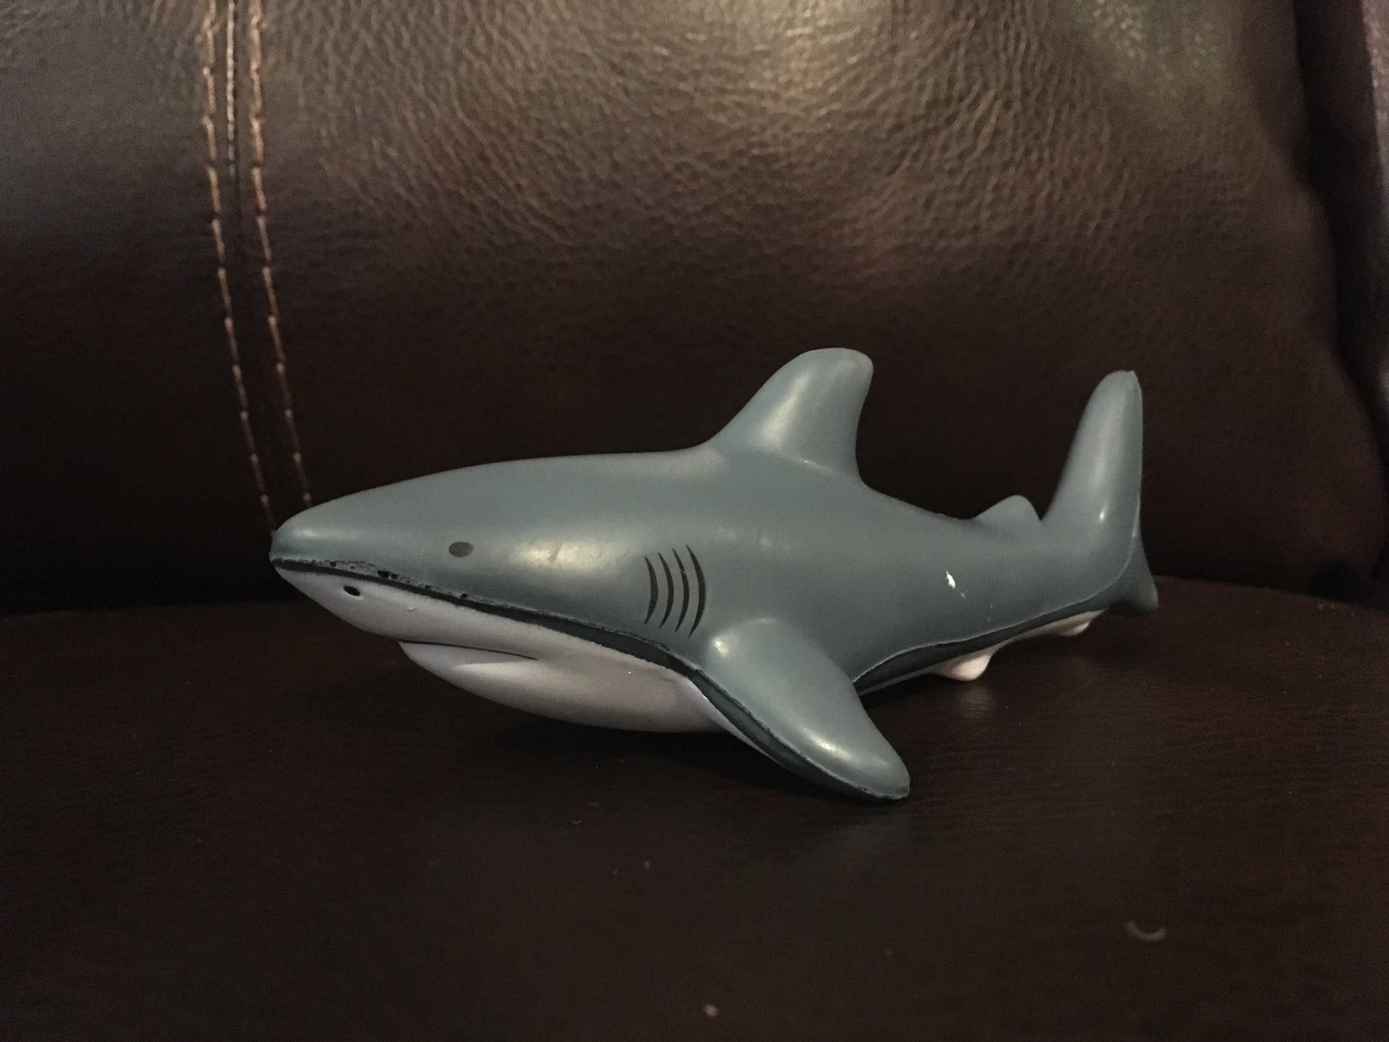
Box #5 Toy Shark

Slide 7
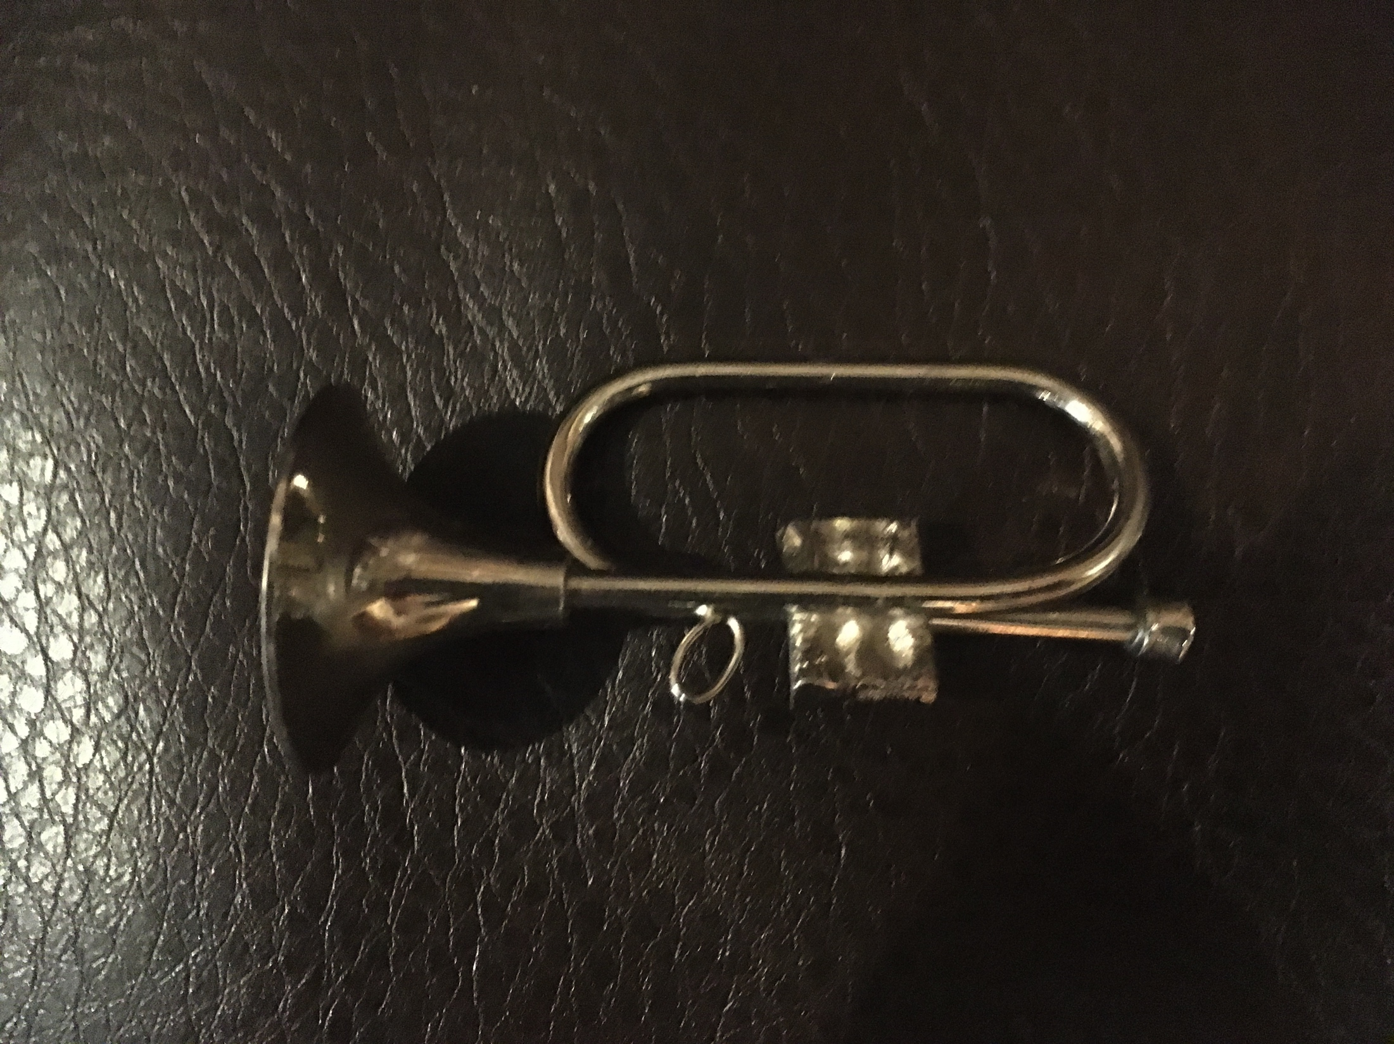
Box #6 Trumpet

Slide 8
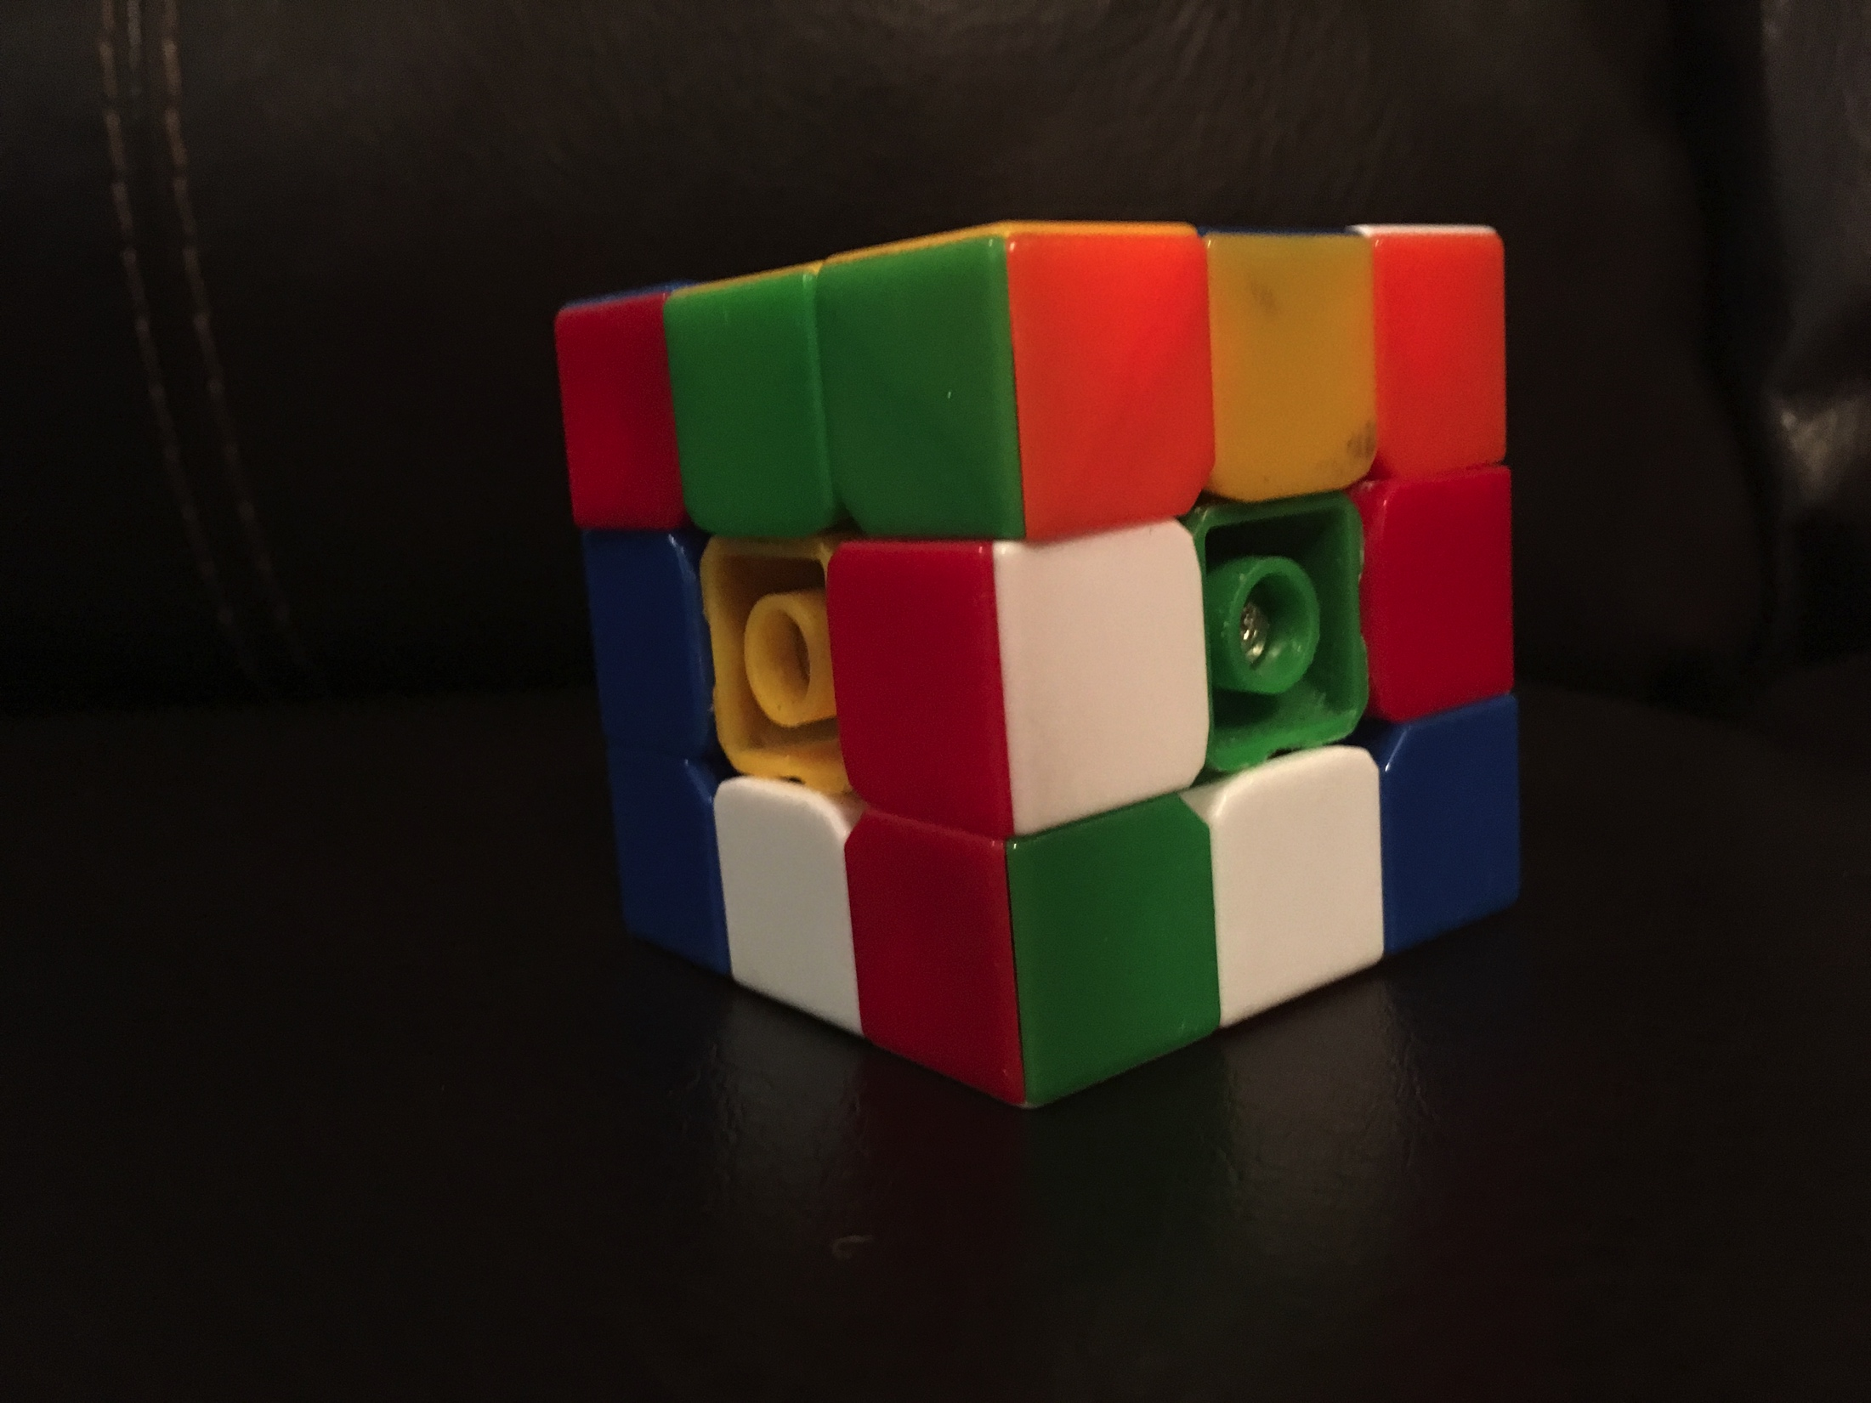
Box #7 Rubiks Cube

Slide 9
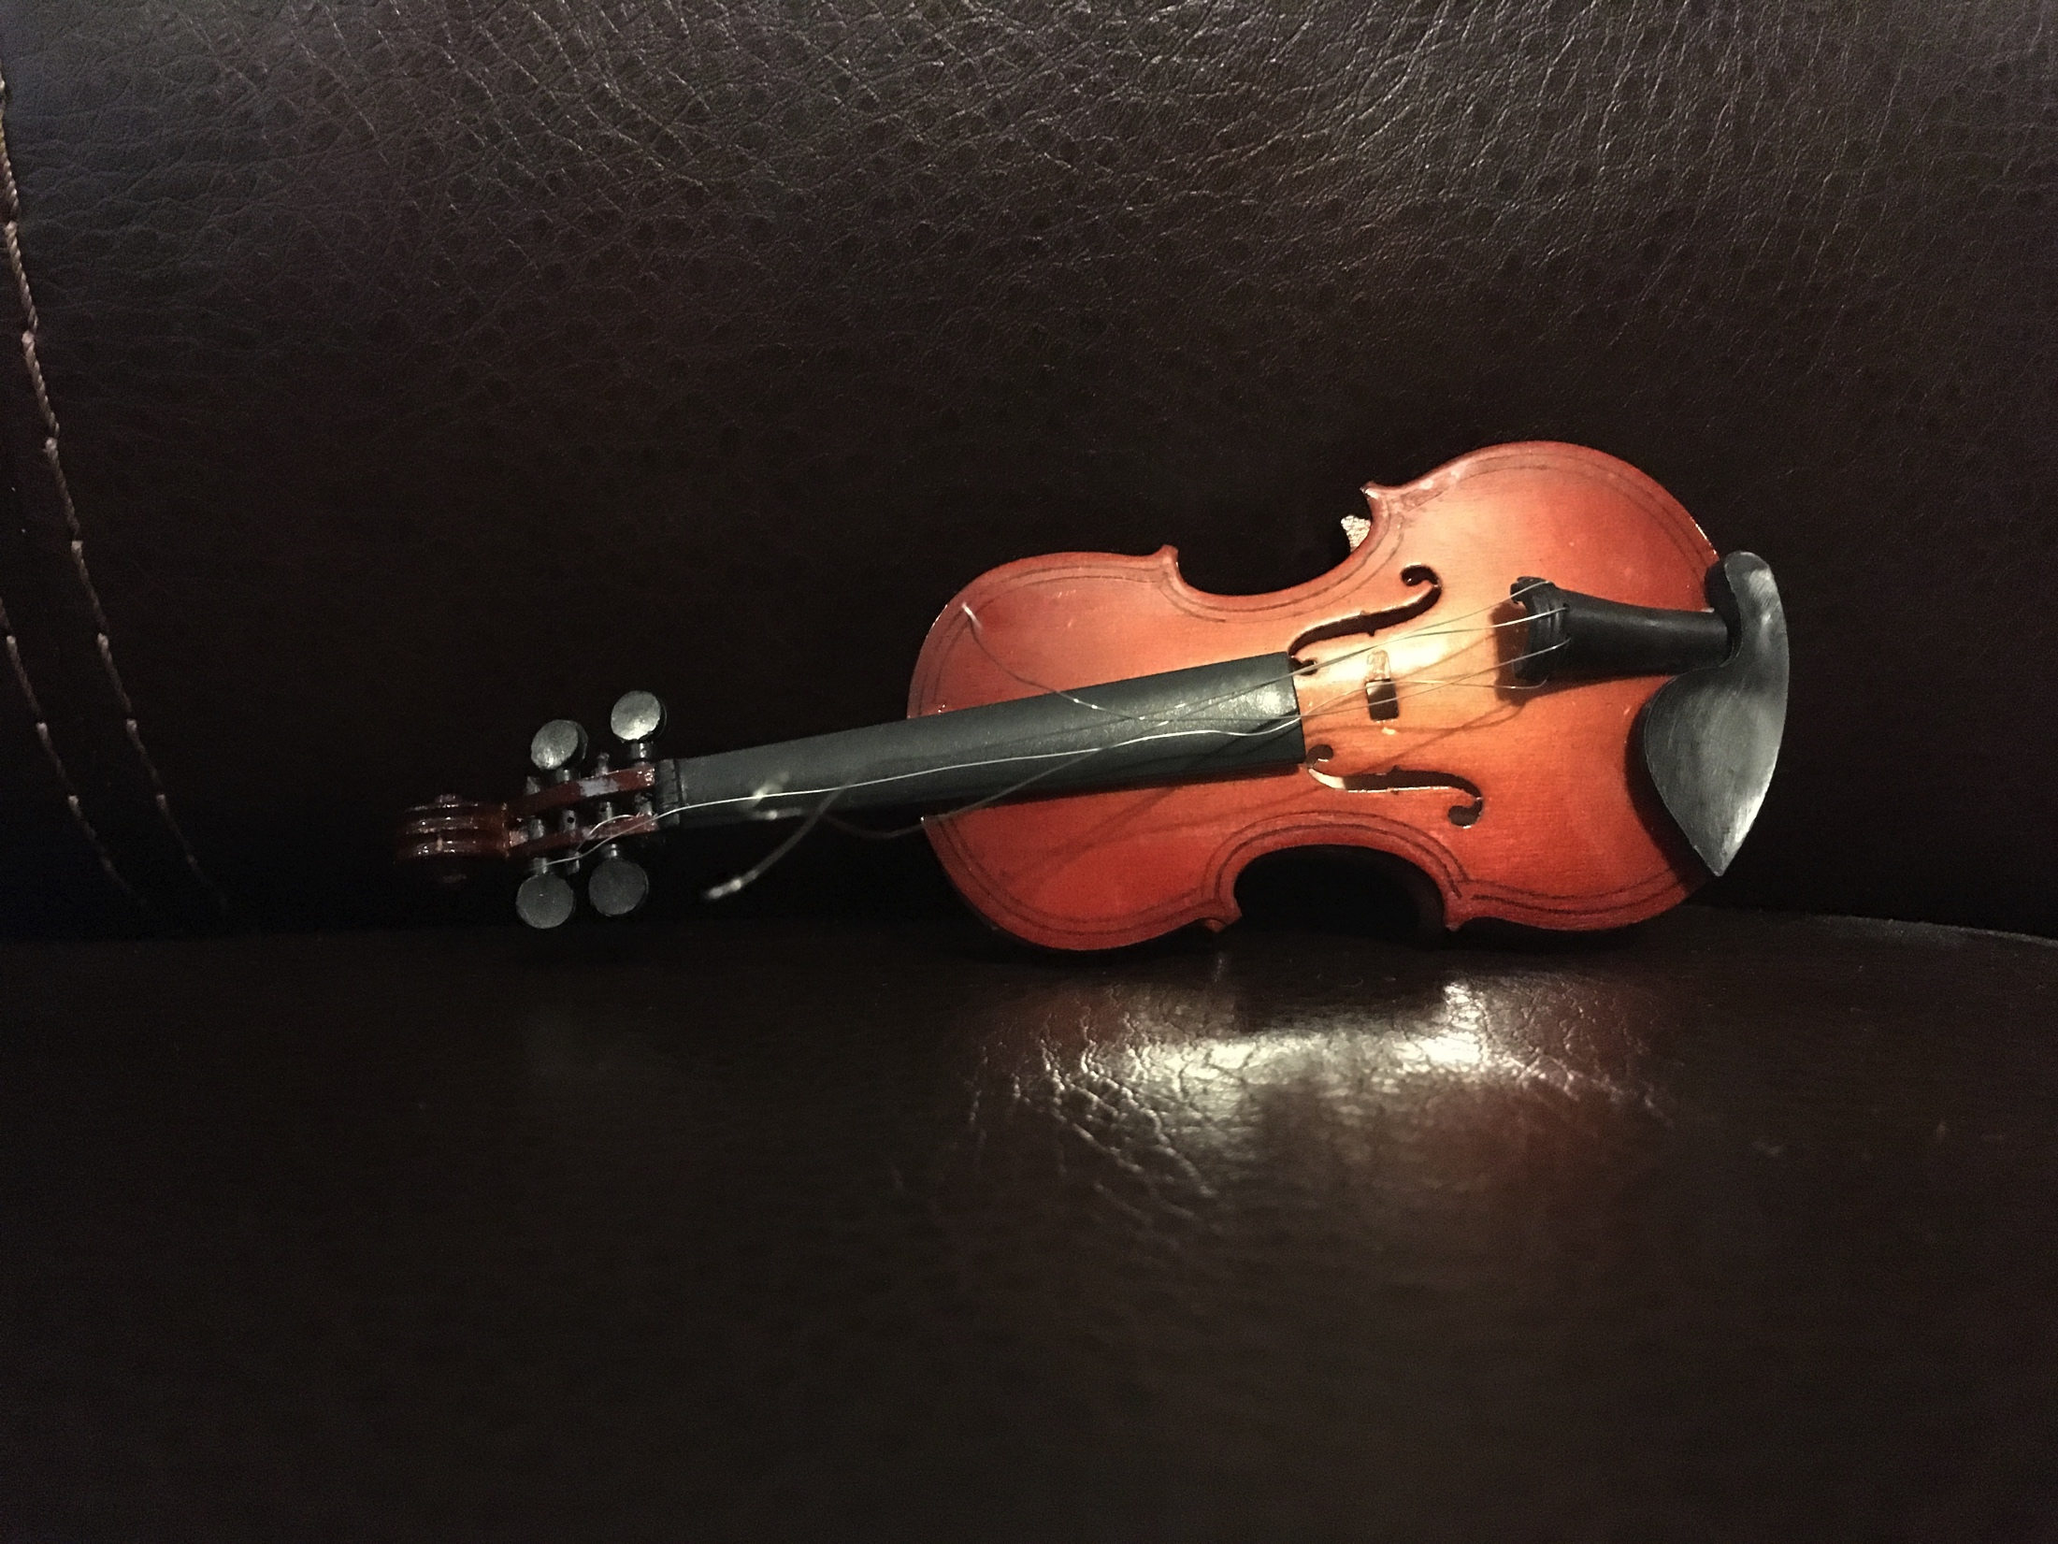
Box #8 Violin

