Slide 1
Physics Final Review
8th Grade Science

Slide 2
Newton’s Laws

Slide 3
Newton’s 1st Law
A object in motion/at rest will stay in motion/at rest unless acted on by another force.

Slide 4
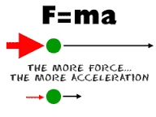
Newton’s 2nd Law
The force acting on an object is equal to its mass times acceleration.

Slide 5
Newton’s 3rd Law
For every action there is an equal and opposite reaction.

Slide 6
Potential and Kinetic Energy

Slide 7
Potential Energy
Stored energy that COULD do work

Slide 8
Chemical Potential Energy
Energy that will be released during a chemical reaction.
Examples:
Food
Battery
Gasoline

Slide 9
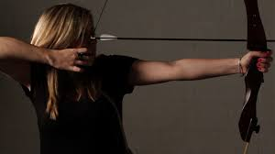
Gravitational Potential Energy
Energy because of its position.
Examples:
Rock at top of hill
Bow string pulled back

Slide 10
Kinetic Energy
Energy that DOES work.

Slide 11
Mechanical (Kinetic Energy)
Energy of motion.

Slide 12
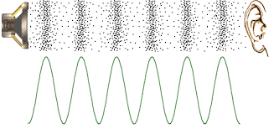
Sound (Kinetic Energy)
Movement of energy through waves by vibrations.

Slide 13
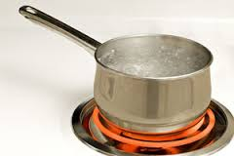
Heat (Kinetic Energy)
Movement of energy through particles.

Slide 14
Energy Types

Slide 15
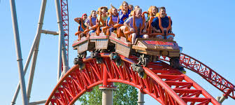
Mechanical
Transfer of energy through motion.

Slide 16
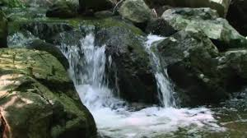
Kinetic
Energy the DOES work.

Slide 17
Potential
Stored energy that COULD do work.

Slide 18
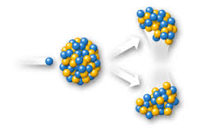
Nuclear
Energy that is released from a nuclear reaction.

Slide 19
Electrical
Energy found in the current of electrons.

Slide 20
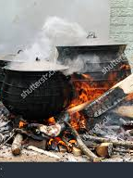
Heat/Thermal
Transfer of energy through particles. Measured by temperature.

Slide 21
Chemical
Stored energy in any type of fuel source.

Slide 22
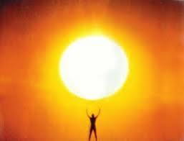
Light
Energy from the sun or any luminous object.

Slide 23
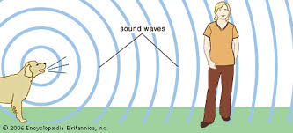
Sound
Transfer of energy through waves by vibrations.

Slide 24
Transfer of Energy

Slide 25
Blow Dryer
Energy transfers from
Electrical
To
Heat

Slide 26
Apple Tree
Energy transfers from
Light
To
Chemical

Slide 27
Guitar
Energy transfers from
Mechanical
To
Sound

Slide 28
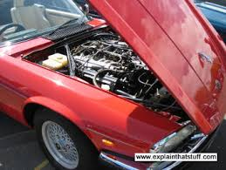
Car Engine
Energy transfers from
Chemical
to
Mechanical

Slide 29
Light Bulb
Energy transfers from
Electrical
To
Light

Slide 30
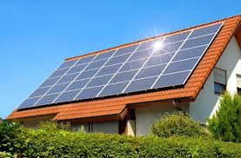
Solar Panel
Energy transfers from
Light
To
Electric

Slide 31
Waves

Slide 32
Amplitude
How high a wave is from the resting point.

Slide 33
Crest
The highest point on a wave.

Slide 34
Trough
The lowest point on a wave.

Slide 35
Wavelength
The distance between corresponding points on 2 consecutive waves.

Slide 36
Frequency
How many waves there are in a certain amount of time.

Slide 37
Medium
The substance that the wave travels through.

Slide 38
Transverse Wave
Wave particles move up and down (perpendicular) to the direction of wave motion.

Slide 39
Longitudinal Wave
Wave particles move back and forth (parallel) to the direction of wave motion.

Slide 40
Compression
When the particles are close together in a longitudinal wave.

Slide 41
Rarefaction
When the particles are far apart in a longitudinal wave.

Slide 42
Label the parts of the wave.
Crest
Wavelength
Amplitude
Trough
Wave Type: Transverse Wave

Slide 43
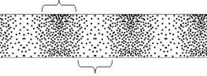
Label the parts of the wave
Compression
Wavelength
Rarefaction
Wave Type: Longitudinal Wave

Slide 44
Pitch and Loudness

Slide 45
The higher the PITCH, the higher the frequency. The LOUDER the sound, the higher the amplitude.

Slide 46
Analog vs. Digital

Slide 47
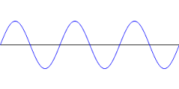
Analog
Continuous electric pulses of varying amplitudes | Definition
Continuous | Signal
Sine or Transverse | Wave Type
Records, Cassette Tapes, Speech | Examples
Records AS IS | Technology
CAN be affected by noise during transmission | Response to Noise
 | Picture

Slide 48
Digital
Definition | Translates information into binary format with two distinct amplitudes. (0 or 1)
Signal | Individual bits of information.
Wave Type | Square waves
Examples | CD’s, DVD’s, Digital devices
Technology | Converts analog waves to binary format.
Response to Noise | Noise immune
Picture
1
0

